Slide 1
We’ve Talked the Talk, Now it’s Time to Walk the Walk:​
Activating DEIA in your Marketing Strategies ​
BY: DANIEL ACOSTA & ANDREA CUEVAS

Slide 2
Digital Acknowledgement
Since our activities are shared digitally to the internet, let's take a moment to consider the legacy of colonization embedded within the technology, structures, and ways of thinking we use every day.
We are using equipment and high-speed internet, not available in many communities. Even the technologies that are central to much of the art we make leaves significant carbon footprints, contributing to changing climates that disproportionately affect communities that are already facing numerous inequities. I invite you to join us in acknowledging all this, as well as our shared responsibility to make good of this time and for each of us to consider our roles in reconciliation, decolonization, and ally-ship.
Adapted from original words by Adrienne Wong

Slide 3
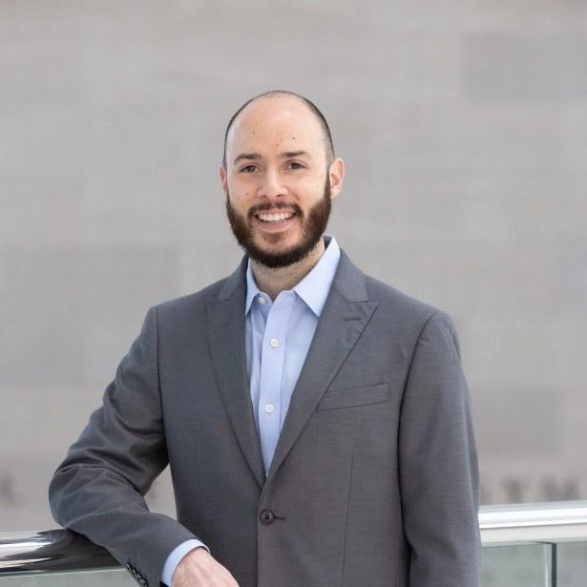
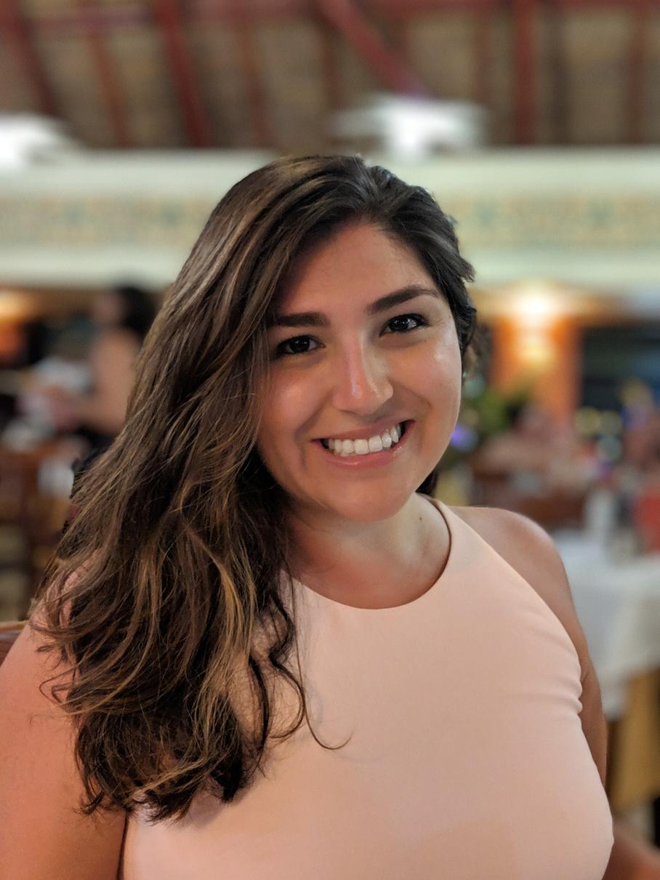
Daniel Acosta
Andrea Cuevas
he/him
she/her
Advertising & Sales Manager
The Dallas Opera (Texas)
Director of Marketing & Communications
Hartford Stage (Connecticut)

Slide 4
In this session, you'll learn how to:
1. Connect your organization's commitments to your strategies
2. Craft communications for multiple audience segments
3. Recognize and remove obstacles that might be preventing you from retaining new audiences
Disclaimer: We represent just two perspectives from two different backgrounds and experiences. This is all a work in progress.

Slide 5



Connecting your organization's commitments to your strategies
BUDGET ALLOCATION
VENDORS & PARTNERS
BRANDING

Slide 6
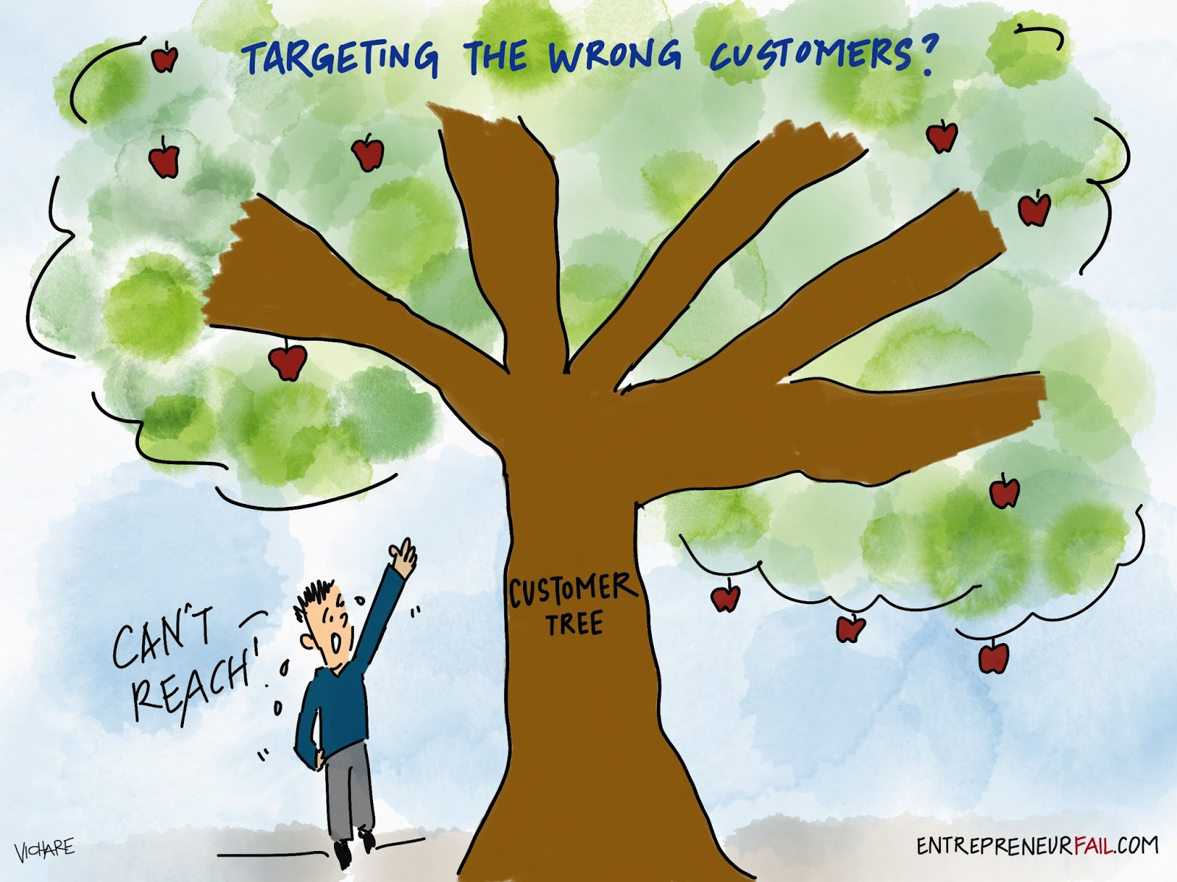
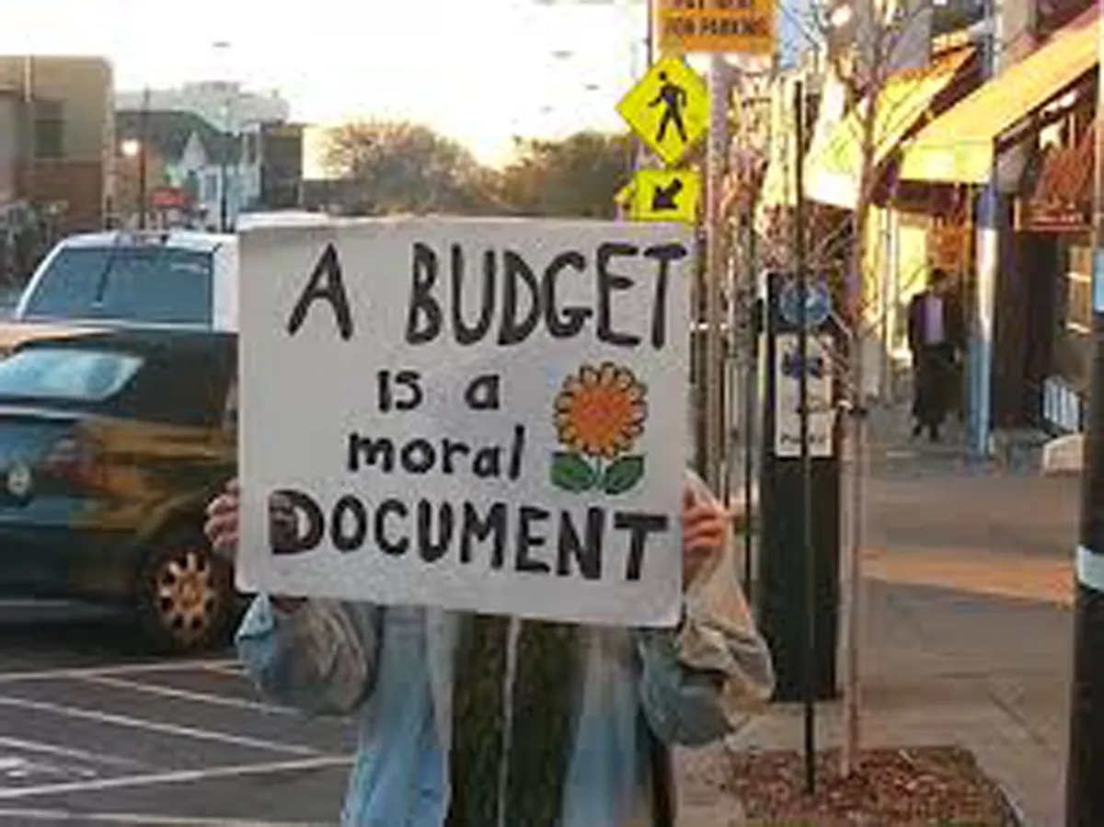

Budget Allocation
Re-frame your definition of success to match your goals
More than just finances — time, energy, relationships
Connecting Your Organization's Commitments To Your Strategies

Slide 7
Budget Allocation
Where are you placing your media dollars?
Are you equitably compensating your consultants?
“Expenses”
“Investments”
Connecting Your Organization's Commitments To Your Strategies

Slide 8
Vendors & Partners
Who are you working with – and why?
Do your values align? Are they reflecting of the community you want to welcome?
Don't be afraid to take risks. Working with new partners may be new for both of you but you'll never learn if you don't try.
New vendors will help you spread word-of-mouth and build relationships with other potential partners.
Connecting Your Organization's Commitments To Your Strategies

Slide 9
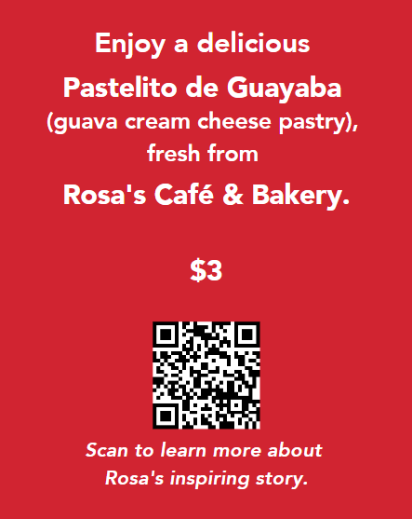
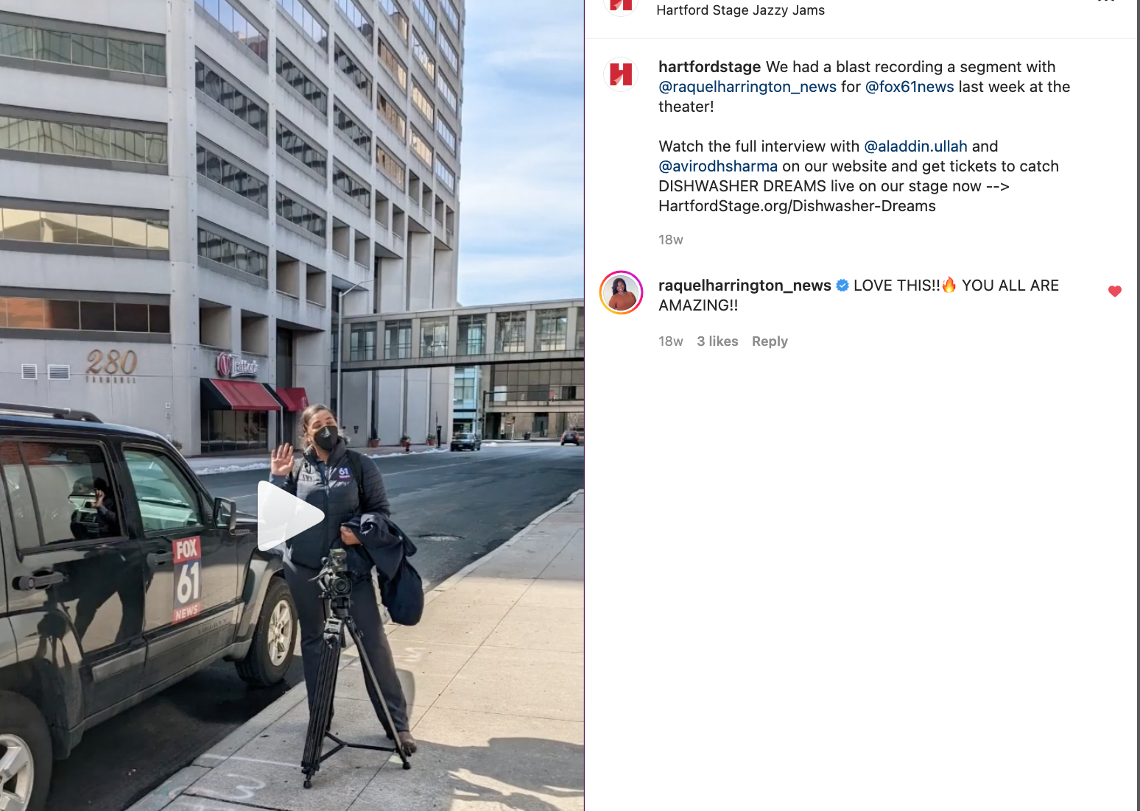
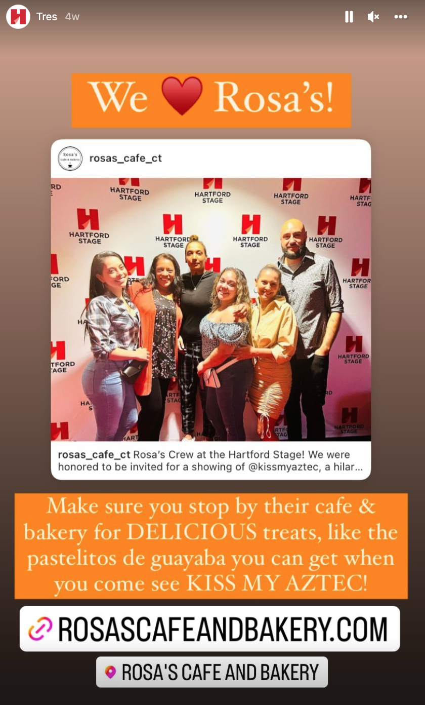
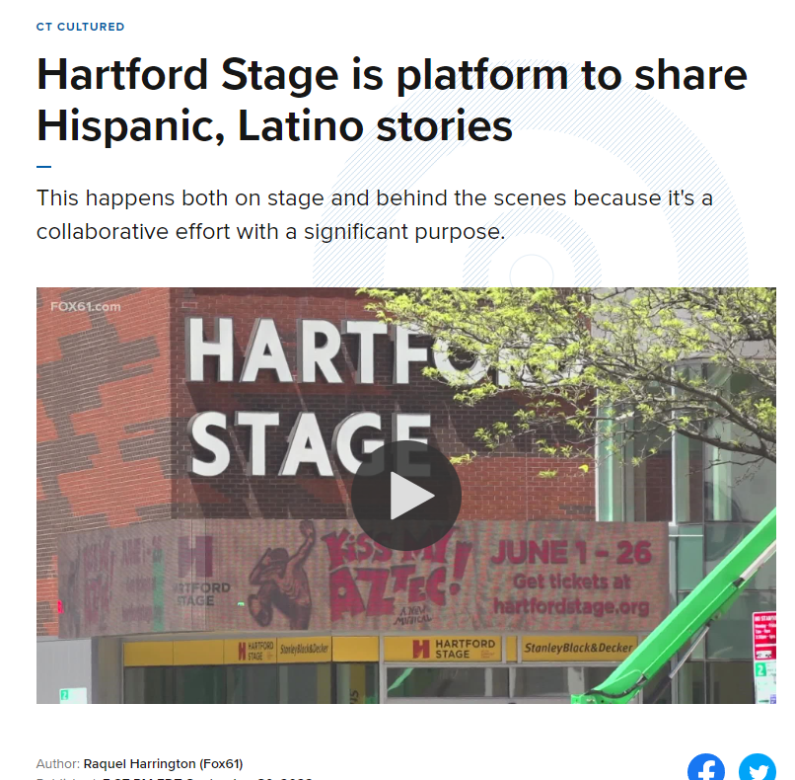
Budget Allocation
Connecting Your Organization's Commitments To Your Strategies

Slide 10
Branding
IMAGERY
Who is represented on the stage, audience, & orchestra?
Are we showing a true version of who we are?
Do our materials reflect the diversity of the communities we serve/or the community we want?
Connecting Your Organization's Commitments To Your Strategies

Slide 11


Branding
IMAGERY
Connecting Your Organization's Commitments To Your Strategies

Slide 12
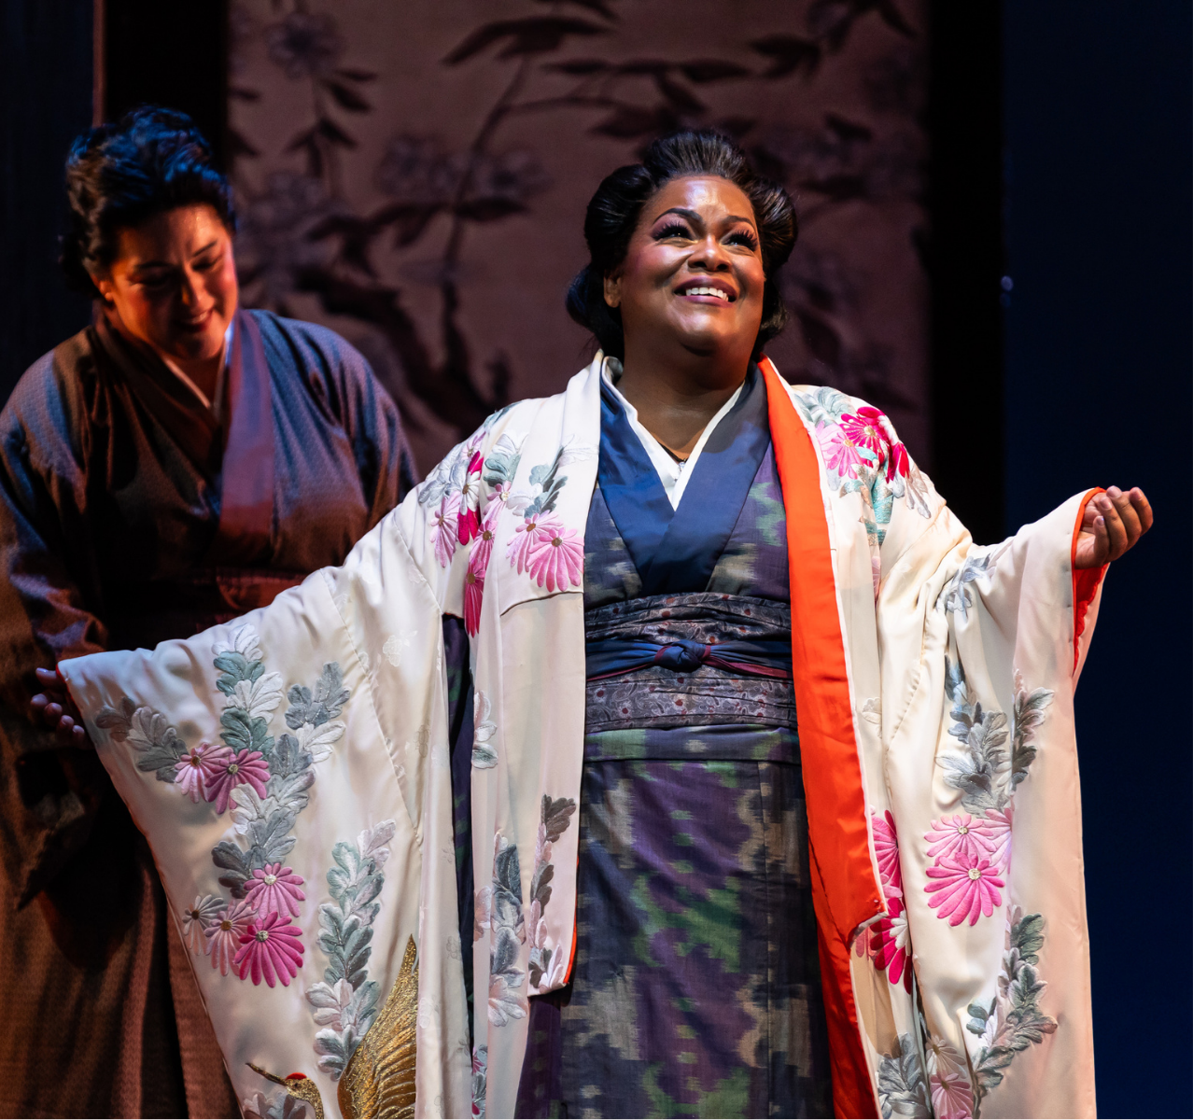
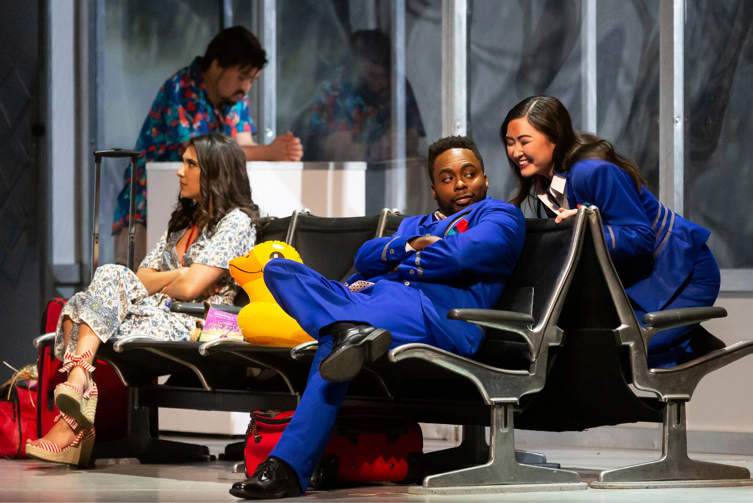

Branding
REPRESENTATION MATTERS
Latonia Moore as Cio-Cio-San Madame Butterfly, Feb. 2022
The Dallas Opera
Jonathan Dove’s Flight, Mar. 2022
The Dallas Opera
Connecting Your Organization's Commitments To Your Strategies
Scott Suchman, Lynn Lane

Slide 13
Branding
SYNOPSIS/COPY
Are we approaching our performance notes or descriptions in a holistic way?
Whose point of view are we telling the story from? Do the words we use reflect our DEI work and goals?
Connecting Your Organization's Commitments To Your Strategies

Slide 14
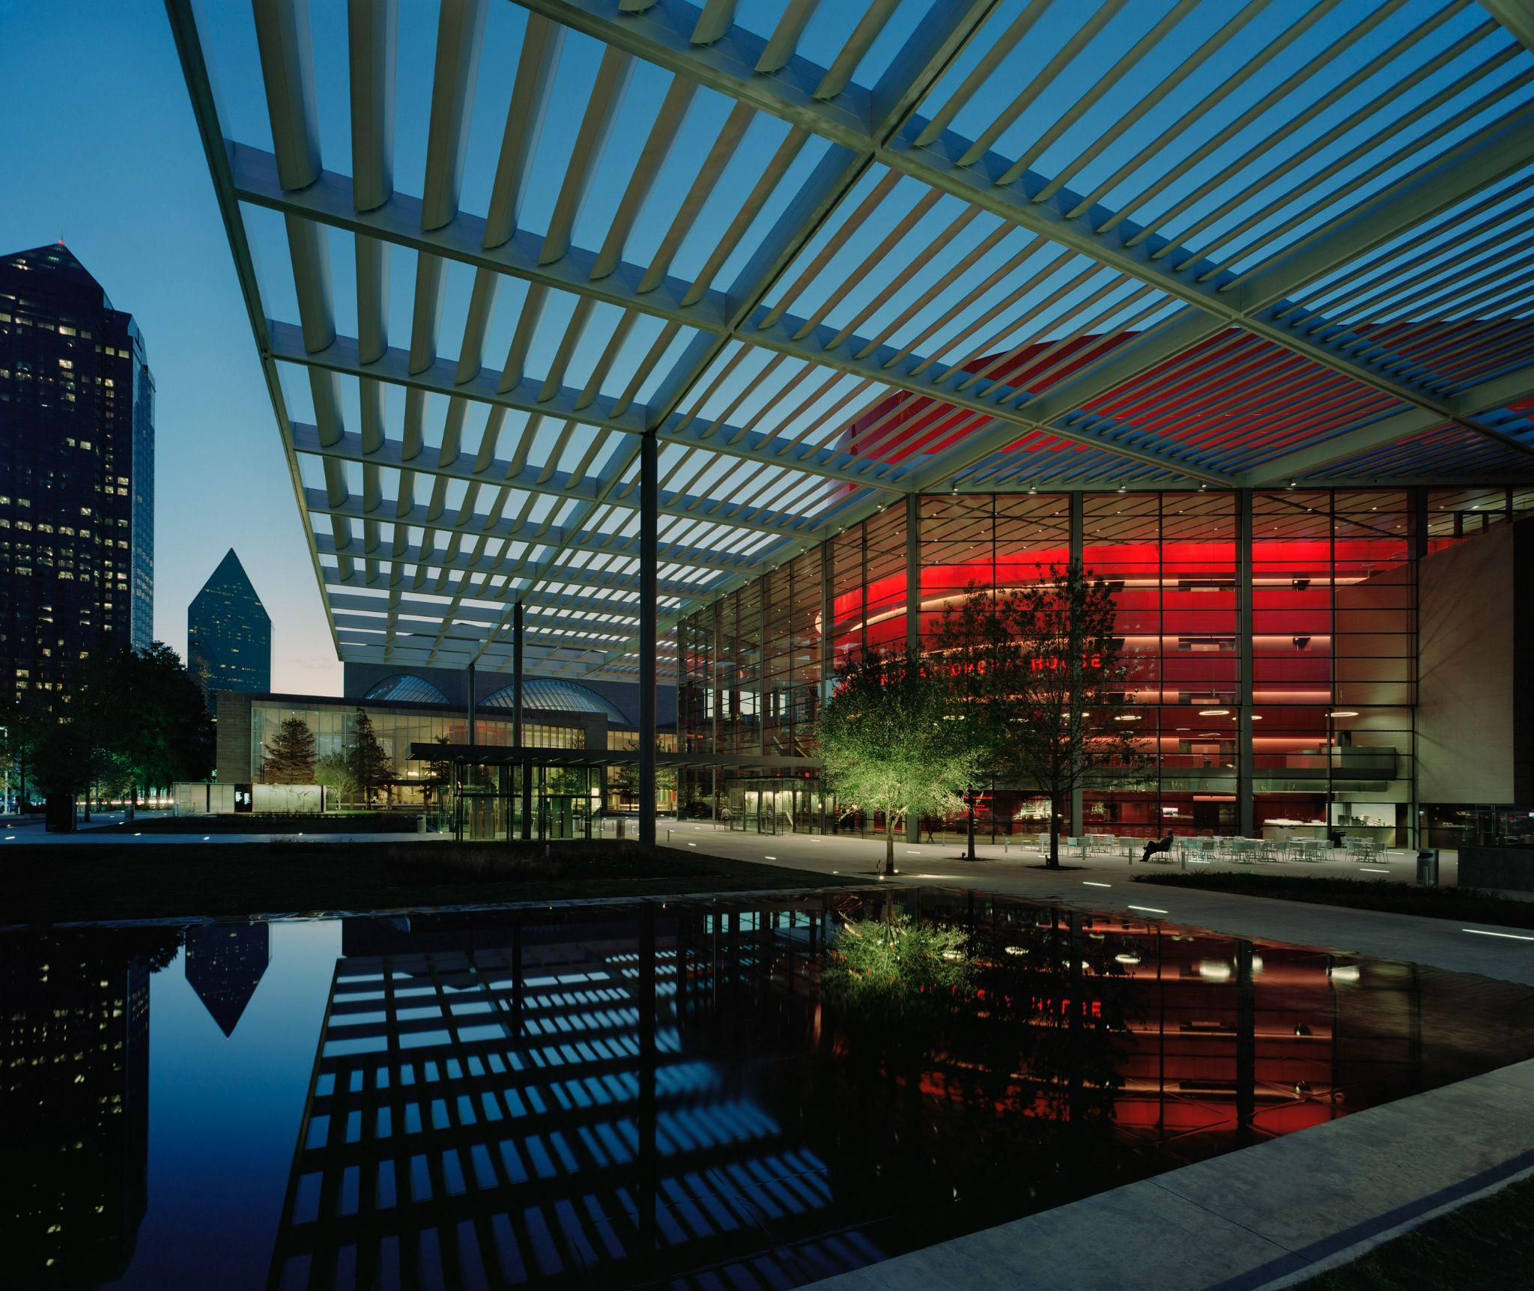
Branding
SYNOPSIS/COPY
Winspear Opera House Dallas, TX
Connecting Your Organization's Commitments To Your Strategies

Slide 15
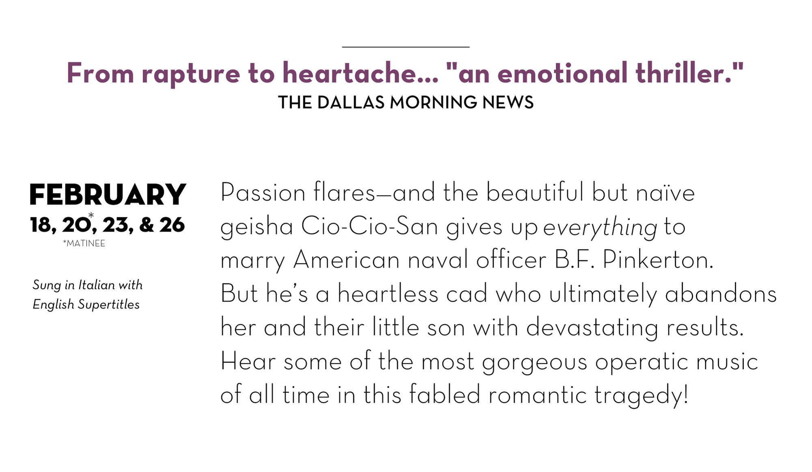
Branding
SYNOPSIS/COPY
Connecting Your Organization's Commitments To Your Strategies

Slide 16
Branding
SYNOPSIS/COPY
Revised line:
Passion flares —and the beautiful but trusting Cio-Cio-San gives up everything to marry American naval officer B.F. Pinkerton.
Variation:
Family…honor…and even her life…Cio-Cio-San gives up everything for her heartless lover.
Connecting Your Organization's Commitments To Your Strategies

Slide 17
Branding
Who are we inviting to the table?
STRATEGY IS KEY
affinity groups
Company Culture Manager
artists
staff
community
The Asian Opera Alliance
board
TDO Connections
Explores thematic elements relevant to our communities through select opera productions and creates a space for learning.
Connecting Your Organization's Commitments To Your Strategies

Slide 18



Crafting communications for multiple audience segments​
BEWARE "INSIDER" PHRASES
ONE AD MAY NOT FIT ALL
CENTER ACCESSIBILITY

Slide 19

Beware “Insider” Phrases
“Most Economical”
“Affordable”
“Guaranteed Seating”
“Mid-week Escape”
“Free Drink Voucher”
Crafting Communications For Multiple Audience Segments​

Slide 20
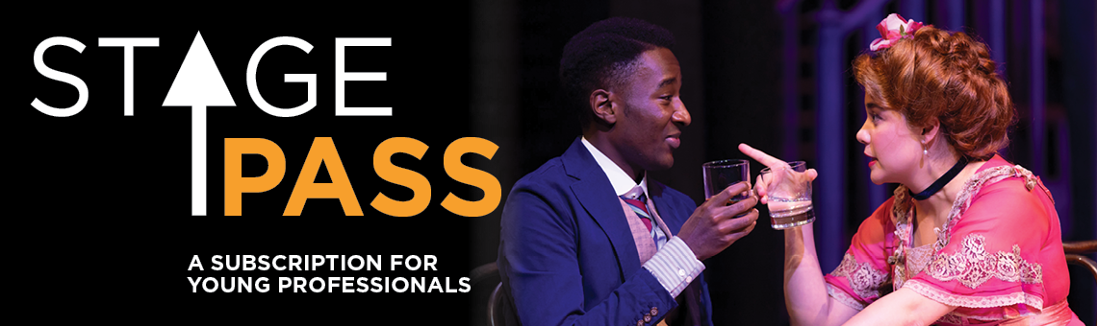
Beware “Insider” Phrases
Production photos can be clever, but may send confusing signals.
Crafting Communications For Multiple Audience Segments​

Slide 21
Beware “Insider” Phrases
Our language choices may be subjective, alienating, or confusing new audiences.
Align with other industries to use familiar phrases.
Crafting Communications For Multiple Audience Segments​

Slide 22






Beware “Insider” Phrases
SUBSCRIPTIONS
SEASON TICKETS
“Single Tickets” vs “Tickets”
“Individual shows”, “performances”, “concert tickets”
Crafting Communications For Multiple Audience Segments​

Slide 23
Beware “Insider” Phrases
Your language choices may be subjective, alienating, or confusing new audiences.
Align with other industries to use familiar phrases.
Provide definitions and FAQs to guide new audiences through their journey.
Crafting Communications For Multiple Audience Segments​

Slide 24
One Ad May Not Fit All
Not all audiences need the same information, or are interested in the same benefits.
If you're investing in new media opportunities, be thoughtful about what information that new audience may want or need.
Crafting Communications For Multiple Audience Segments​

Slide 25
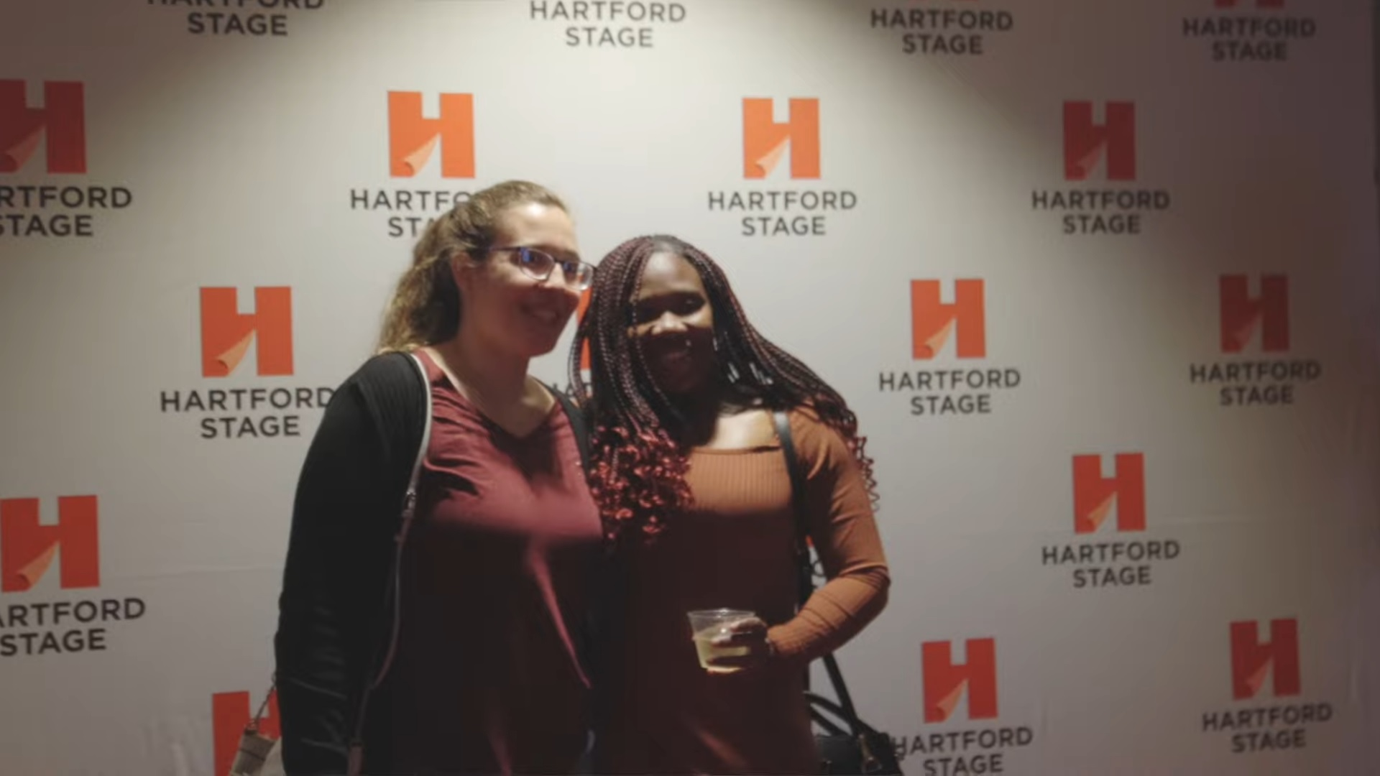
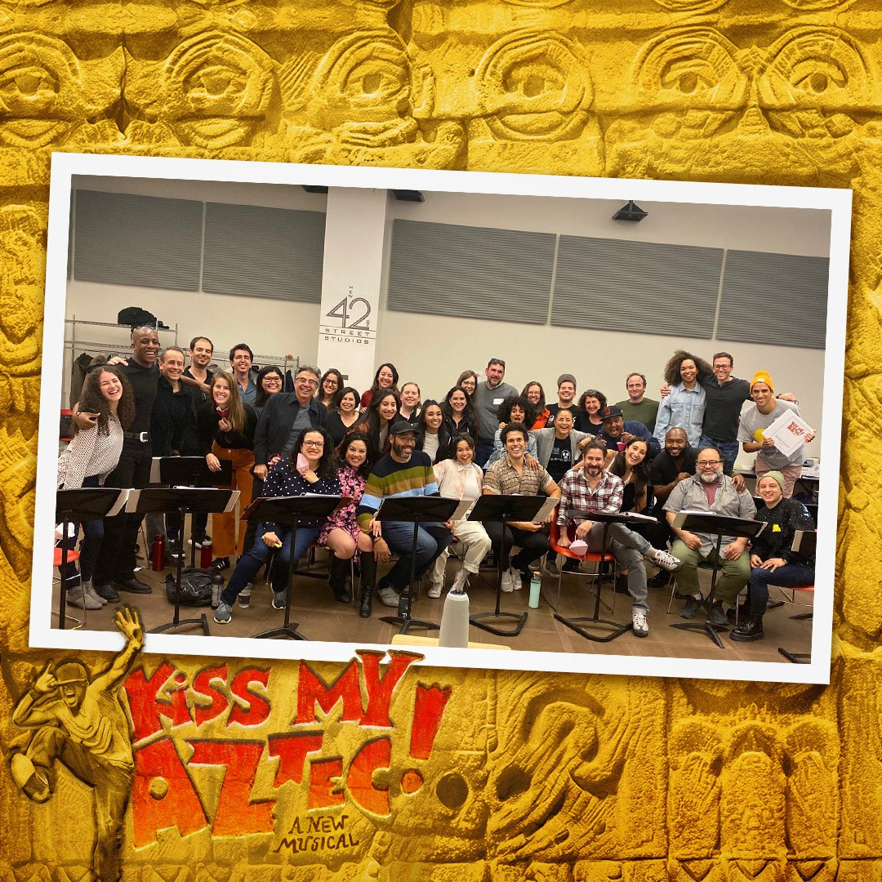
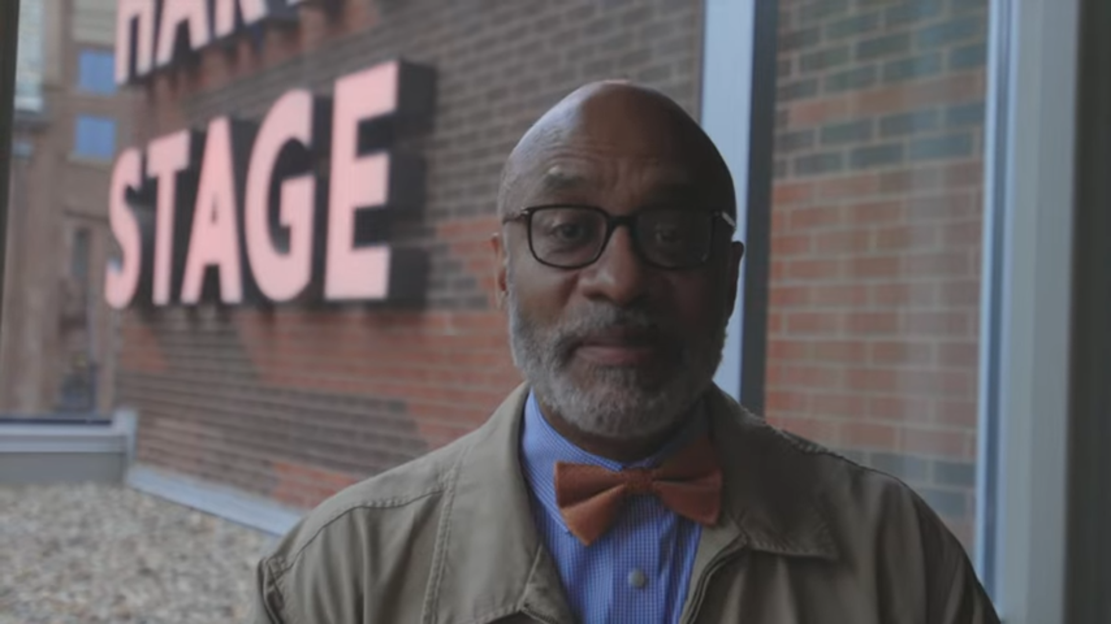
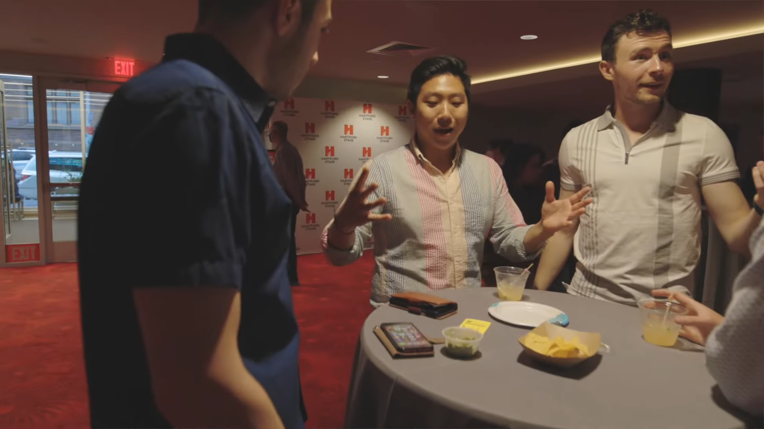
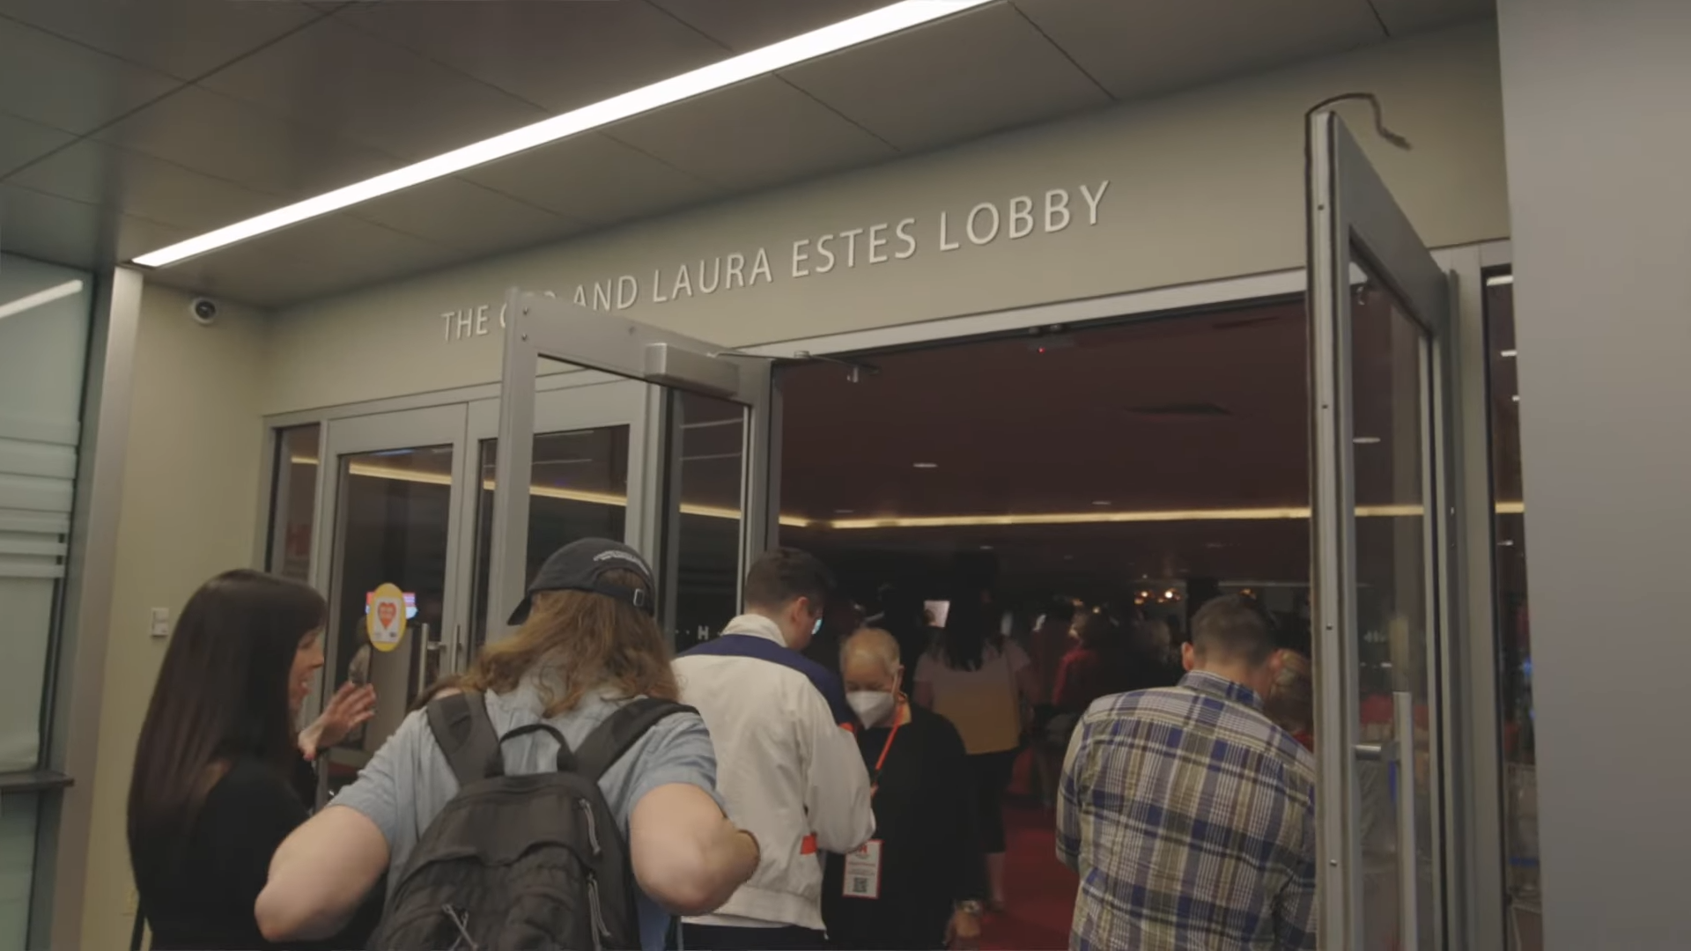
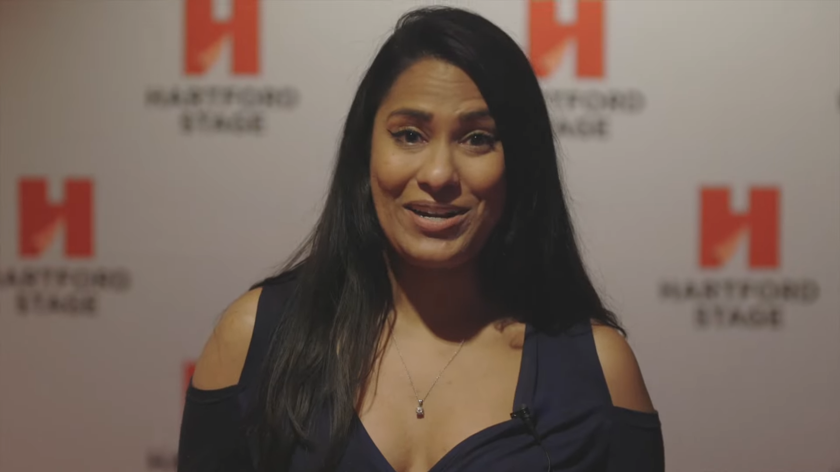
One Ad May Not Fit All
Crafting Communications For Multiple Audience Segments​

Slide 26
Center Accessibility
CURB-CUT EFFECT
Centering the needs of underserved people often has a broader impact on the community.
Digital Programs help:
people who use screen readers
people who use translation tools
anyone who wants to learn more about the show in advance
the environment
Crafting Communications For Multiple Audience Segments​

Slide 27
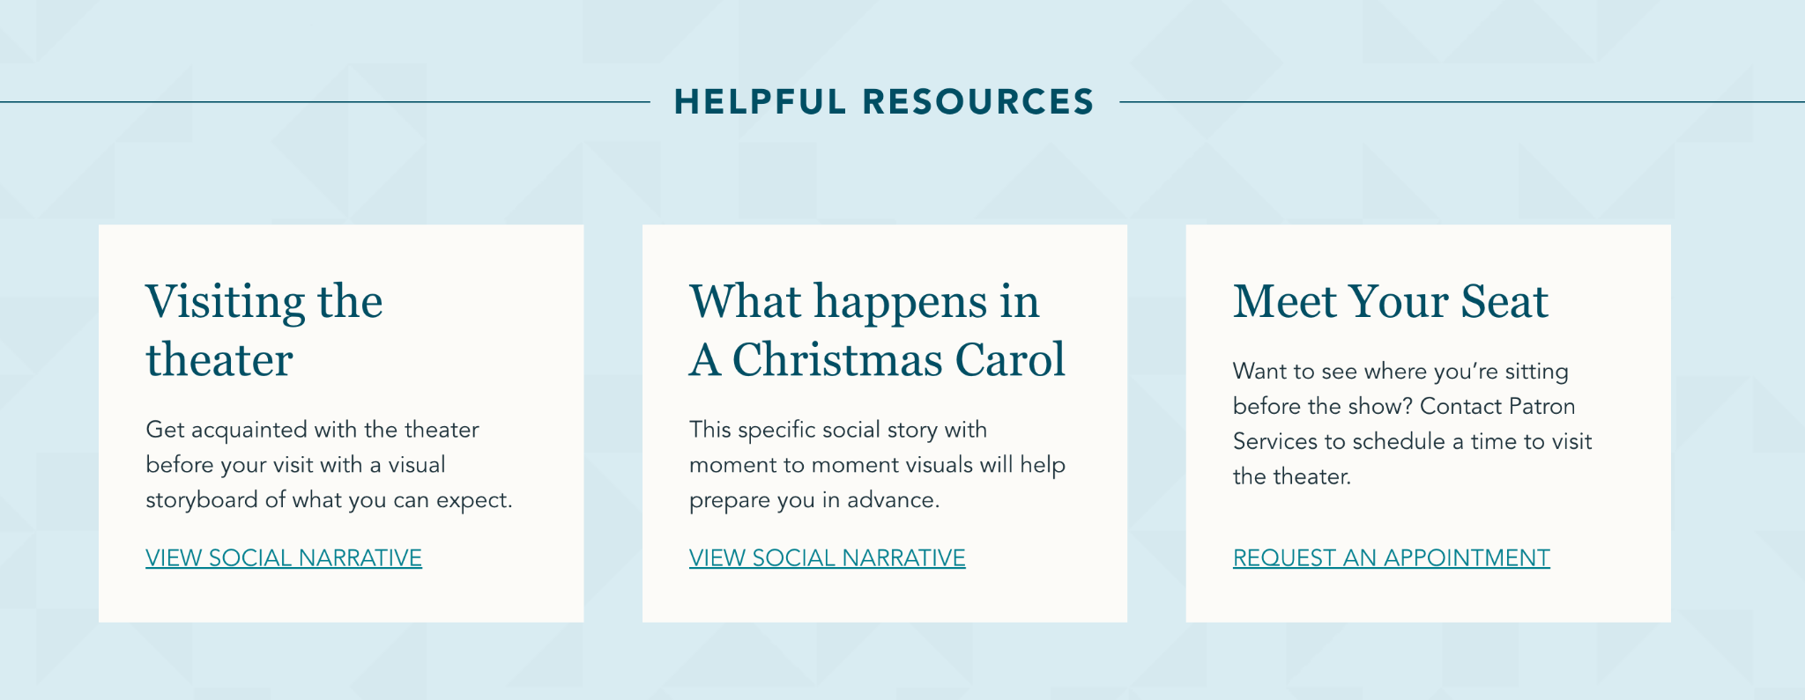
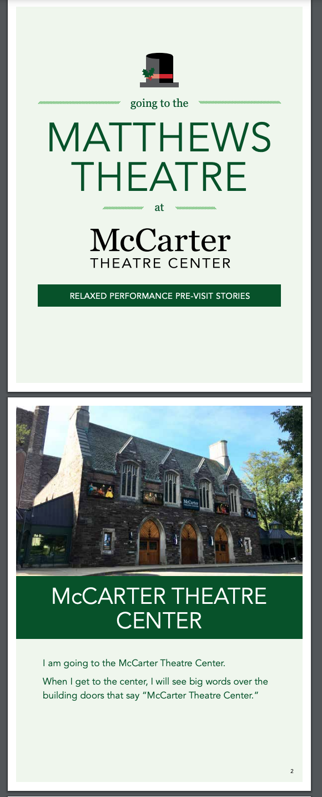
Center Accessibility
Crafting Communications For Multiple Audience Segments​

Slide 28
Center Accessibility
Features like digital programs, captions, quiet rooms, high contrast text, meet-the-seat opportunities, family restrooms, etc. help more people than you may realize.
If you need to make changes to accommodate new audiences, your "old" audience can learn and come with you! One does not cancel out the other.
Always keep learning. Look to experts for advice.
Crafting Communications For Multiple Audience Segments​

Slide 29


Recognizing and removing obstacles that might be preventing you from retaining new audiences​
LEARN
IMPLEMENT
?
ASK

Slide 30

LEARN THE COMMUNITY'S
NEEDS AND WANTS
IMPLEMENT,
TRAIN,
SUPPORT
ASK FOR
FEEDBACK

Slide 31
LEARN THE COMMUNITY'S
NEEDS AND WANTS
Foster relationships
Create short-term and long-term goals
Set aside a TBD budget

Slide 32
Invite community experts to be part of the planning/training process​
Provide resources to staff, artists, and audiences so they understand variations of behaviors, remind and connect to commitments​
Lead by example, show empathy, don't be afraid to make mistakes
IMPLEMENT,
TRAIN,
SUPPORT

Slide 33
Send audience surveys​
Follow-up with community leaders​
Learn from staff experiences​
ASK FOR
FEEDBACK

Slide 34
Don’t forget…
1. You can't expect transformation overnight.
2. You have limited amount of resources, including time and energy. Be mindful of who you're offering that to.
3. Collaboration and flexibility are key.
4. Ask for and value feedback, even if it's uncomfortable.
BY: DANIEL ACOSTA & ANDREA CUEVAS

Slide 35

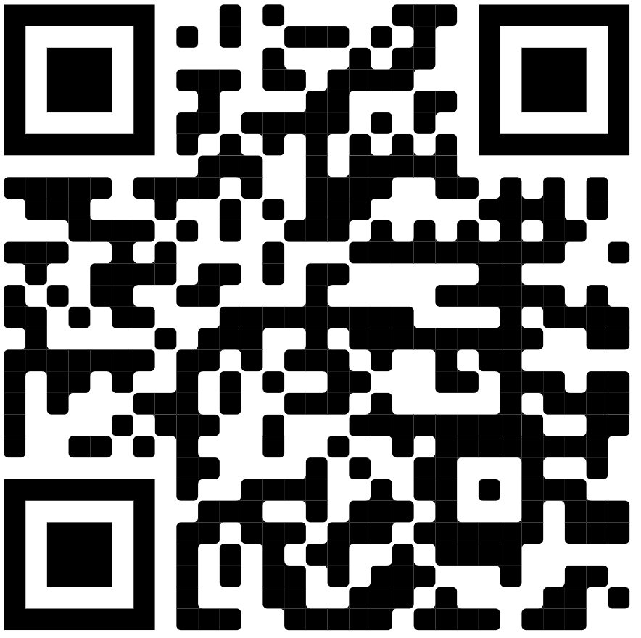



Daniel Acosta
Andrea Cuevas
DANIEL.ACOSTA@DALLASOPERA.ORG
ACUEVAS@HARTFORDSTAGE.ORG
Thank You!
…and viewers like you

Slide 36


Resources:
READING
GROUPS
Decolonizing Wealth: Indigenous Wisdom to Heal Divides & Restore Balance Edgar Villanueva
TDO Connections dallasopera.org/tdo-connections
The Art of Gathering: How We Meet and Why It Matters Priya Parker
artEquity artequity.org
Tessitura’s Early Career Development Program tessituranetwork.com/Support/ Training/Early-Career-Development
Nonprofit AF Vu Le
The Silo Effect: The Peril of Expertise and the Promise of Breaking Down Barriers Gillian Tett

Slide 37



Resources:
WATCHING
Tessitura’s DEIA Learning Series tessituranetwork.com/Support/Resources/Videos
LISTENING
CI to Eye Capacity Interactive
Diversity and Inclusion in Marketing: Inclusive Language for Marketers
LinkedIn Learning
From The Suggestion Box Nicole R. Smith
TOOLS
HBR IdeaCast Harvard Business Review
Color Contrast Checker
webaim.org/resources/contrastchecker/
Arts. Work. Life. The Association of Performing Arts Professionals
Website Accessibility Evaluation Tool
wave.webaim.org/
Captions & Translations
rev.com

Slide 38
What are you doing at your organization to build diversity, equity, inclusion, and accessibility within your marketing strategy?

