Slide 1
Addressing bias in data with a system of empowerment

Slide 2
INTRODUCTION
Belonging project
MUPS antiracism work
A little about me

Slide 3
ROADMAP FOR TODAY
What bias looks like
Why data ethics are important to our DEAI work
Systems of empowerment
Bringing belonging to our data projects
Data project resources

Slide 4
We all have a place in this work.

Slide 5
What does bias look like?

Slide 6
WHAT BIAS LOOKS LIKE
  Original Order of Answers:
  a) Male
  b) Female
  c) Non-binary
  d) Trans man
  e) Trans woman
  f) Prefer to self-describe:_______
  g) Prefer not to answer

Slide 7
WHAT REDUCING BIAS LOOKS LIKE
  After using the randomization feature:
  a) Trans woman
  b) Non-binary
  c) Female
  d) Trans man
  e) Male
  f) Prefer to self-describe:_______
  g) Prefer not to answer

Slide 8
WHAT BIAS LOOKS LIKE

Slide 9
WHAT REDUCING BIAS LOOKS LIKE
Other genders include:
Non-binary
Trans Man
Trans Woman

Slide 10
WHAT BIAS LOOKS LIKE

Slide 11
WHAT REDUCING BIAS LOOKS LIKE
Other people includes:
Prefer not to Answer
Unknown
Mixed race

Slide 12
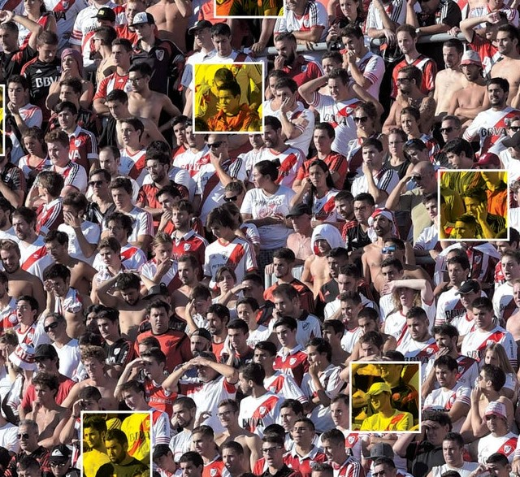
WHY DATA BIAS MATTERS
Emotion AI
Machine Learning

Slide 13
WHY DATA BIAS MATTERS
The arts went digital
We are relying more on data to make business decisions
We may need to outsource

Slide 14
WHY DATA BIAS MATTERS
Digital divide
Lack of diversity in technology
Solutions for users of all abilities

Slide 15
Data accuracy does not mean data is bias free.

Slide 16
WHY DATA BIAS MATTERS
There are different types of bias that directly affect our work in the arts
Historical Bias
Representation Bias
Measurement Bias (feedback loops)

Slide 17
System of empowerment

Slide 18
Digital transformations fail 75% of the time
EMPOWERMENT

Slide 19
DISRUPTION EMPOWERMENT
Massive Transformative Purpose (MTP)
Failing forward
Public support from leadership
Small wins
EMPOWERMENT

Slide 20
MASSIVE TRANSFORMATIVE PURPOSE
Audaciously big and inspirational
Can cause significant transformation to community or planet
There is a clear “why” behind the work being done
EMPOWERMENT

Slide 21
FAIL FORWARD
The room to fail forward
Freedom to experiment
EMPOWERMENT

Slide 22
DECLARE SUPPORT
Staff Meetings
Board Meetings
Newsletters
EMPOWERMENT

Slide 23
SMALL WINS
Small wins go a long way
Pick ONE thing
EMPOWERMENT

Slide 24
SELF-CARE
Go for walks
Drink water
Read
Meditate
EMPOWERMENT

Slide 25
Belonging

Slide 26
THE ELEMENTS OF BELONGING
When You are Seen
When You are Connected
When You are Supported
When You are Proud
BELONGING

Slide 27
THE ELEMENTS OF BELONGING
The Othering and Belonging Institute at UC Berkeley
“Targeted universalism is an approach that supports the needs of the particular while reminding us that we are all part of the same social fabric.”
BELONGING

Slide 28
THE ELEMENTS OF BELONGING
Step #1: Establish a universal goal based upon a broadly shared recognition of a societal problem and collective aspirations
Example: Make the arts accessible to all audience members
BELONGING

Slide 29
THE ELEMENTS OF BELONGING
Step #2: Assess or measure the general population performance relative to the universal goal.
Example: Survey to understand barriers to attend
BELONGING

Slide 30
THE ELEMENTS OF BELONGING
Step #3: Identify groups and places that are performing differently with respect to the goal.
Example: Segment audiences into different groups and learn about their barriers.
BELONGING

Slide 31
THE ELEMENTS OF BELONGING
Step #4: Assess and understand the structures that support or impede each group or community from achieving the universal goal.
Example: Analyze the survey feedback and look for common themes.
BELONGING

Slide 32
THE ELEMENTS OF BELONGING
Step #5: Develop and implement targeted strategies for each group to reach the universal goal.
Example: Send a price offering to one group. Set up a shuttle service for another.
BELONGING

Slide 33
Resources

Slide 34
STAFF DIVERSITY
More Innovation
There are many “right” ways
We all have expertise
We learn from each other
RESOURCES

Slide 35
INCLUSIVE COLLABORATION
Leverage community stakeholder relationships
Include staff from non-data departments
RESOURCES

Slide 36
INCLUSIVE DATA COLLECTION
Inclusive considerations help us reduce bias
Non-digital platforms
Non-ticketed guests
Free events
Greater community
RESOURCES

Slide 37
PLANNING DATA PROJECTS
Build this step into your project timeline
Include your WHY (MTP)
Include a description of data you will collect
Include information on what you will do with the data
RESOURCES

Slide 38
PLANNING DATA PROJECTS
Consider data privacy
Who has access to the data
How long will you have access to it
RESOURCES

Slide 39
DRAFTING SURVEY QUESTIONS
Randomization feature
Avoid cognitive load
Our DEAI committees are a resource
RESOURCES

Slide 40
ANALYZING DATA
Example: Member campaign planning group
We all bring our lived experiences to how we process information
RESOURCES

Slide 41
SHARING DATA
Staff and colleagues
Stakeholders
Survey respondents
RESOURCES

Slide 42
DATA ETHICS AUDITS
Approach data ethics like cybersecurity audits
Where are we getting our data?
RESOURCES

Slide 43
DATA ETHICS AUDITS
Constituent loyalty scoring
Subscriber seating priority
Managing duplicate records
RESOURCES

Slide 44
DATA VENDOR PARTNERSHIPS
Ask HOW they use inclusive practices in their data and hiring practices.
Ask WHAT some of their goals are related to diversity.
Ask WHO makes up their data teams.
RESOURCES

Slide 45
STAFF TRAINING
Bias training
DEAI training
Technical training for data teams
RESOURCES

Slide 46
HUMAN INTERVENTION
Audience Engagement Team
+
Data Team
RESOURCES
Notes:
I

Slide 47
EXAMPLE: Antiracism Workgroup
Data team diversity
Included stakeholders
Drafting survey questions
Presentation to stakeholders
RESOURCES

Slide 48

CHECKLIST: EMPOWERMENT
Empowerment Framework
  Your WHY
  Support to fail forward
  Public support from leadership
  Small wins for momentum
Self-care

Slide 49
CHECKLIST: BELONGING
Four elements of belonging
Targeted Universalism resource

Slide 50
CHECKLIST: RESOURCES
Data team staff diversity
Inclusive collaboration
Planning data projects together
Drafting data collection practices together
Analyzing data together

Slide 51
CHECKLIST: RESOURCES
Sharing data with all
Data ethics audits (frequently revisit data for decision making)
Data vendor partnerships built on shared values
Staff training
Human intervention

Slide 52
CONCLUSION
Your true authentic self
Forgiveness
Celebrate mistakes
Be agile
Listen

Slide 53
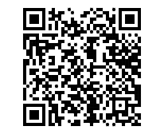
Thank you!
SARAH HERRERA (she/her)
Assistant Director of Business Intelligence
smherrera@ucdavis.edu
Mondavi Center for the Performing Arts,
UC Davis

